Slide 1
Support Vector Machines

Slide 2
Contents
Introduction to SVM
What are Support Vectors, Hyperplanes and Margins.
How does SVM works.
Non-linearly separable data.
The Kernel Trick.
Pros and Cons.

Slide 3
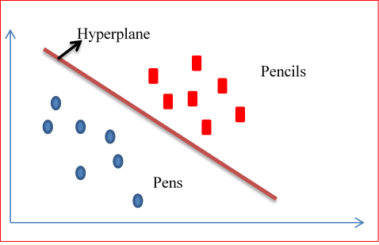
Introduction to Support Vector Machines
Support Vector machines (SVM) come under supervised learning techniques.
This can be used for both Classification as well as Regression problems.
In this technique, we plot the data points in
a graph and find an optimal plane which
can separate both the classes with high
accuracy.

Slide 4
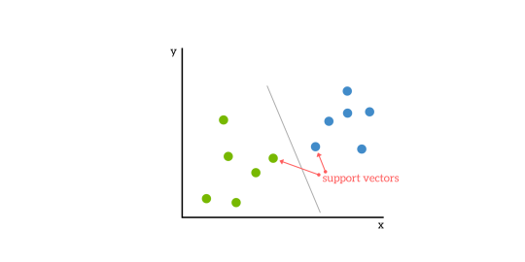
Cont….
Below are the few terms that we come across very often when studying SVM
Support Vectors:
Support vectors are nothing but co-ordinates of individual data points in the data set.
Hyperplane:
Hyper plane is a line which separates two classes very well.
If the points are plotted in multi dimensions we call it as Hyperplane.
Hyperplane

Slide 5
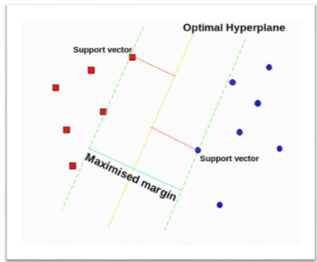
Cont….
Margin:
Margin is the distance between extreme data
points of both the classes.
We will select that hyperplane whose
margin a highest

Slide 6
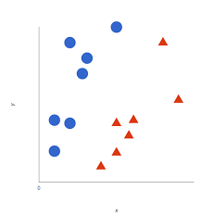
How does it work?
Let’s consider a data set which contain two classes.
Let’s classify them as circles and triangles.
Now, how SVM works is, it will try to identify that optimum plane which completely separates the two classes.

Slide 7
Cont….
As shown in the figure, SVM creates a hyperplane(in this case its just a line) such a class of one type is classified into one side of the line, and the other class to other side of the line.

Slide 8
Cont….
Now, if we see this figure, even these line separate the classes perfectly.
Then why did SVM not select these lines as hyper plane and chose the other line as hyper plane??

Slide 9
Cont….
SVM chooses hyperplane in such a way the margin is maximized.
If you look at the figure, you observe that the algorithm calculates the distance between extreme data points of both classes and will select that region as hyperplane which has maximum Margin.

Slide 10
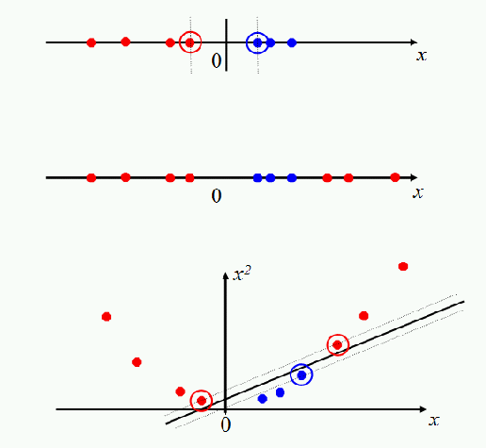
Non-linearly separable data.
Till now whatever we saw was linearly separable.
But what about the data which is non linear?
How does SVM create hyperplane for such data.
For Example: Lets have a look at first two figures. The data is not linearly separable, and hence it is impossible for us to find out the right hyperplane.

Slide 11
Cont….
What we can do here is, we can convert this data into a higher dimensions data and plot in the graph.
The plot will become as shown in the figure.
Now it is easy for us to create a hyperplane.

Slide 12
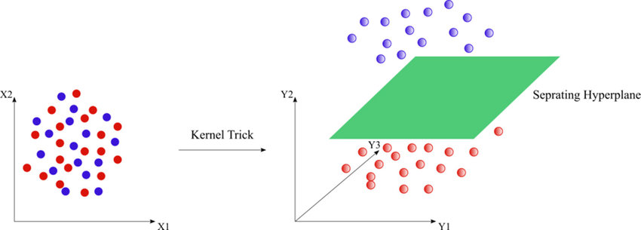
The Kernel Trick
We don’t have to do this manually in SVM.
SVM has a feature called as Kernel trick.
This functions basically converts a lower dimension data and converts it into higher dimensions data, in such a way that we can define a hyper plane
This function does a lot of complex data transformation and finds a hyperplane which can separate the labels correctly.

Slide 13
Pros and Cons….
Pros:
It performs extremely well when the classes are linearly separable.
Effective in higher dimension spaces.
Cons:
Performance is poor if data set is huge, as it requires a longer training period.
Performance is poor if target variables are not linearly separable. It requires a lot of computational power to first convert it to linearly separable and then calculate the plane.

